Slide 1
One Stop Store - Customer Data & Sales Analysis
Presented By-
Rutuja Pachore

Slide 2
agenda
Introduction
Objective
Dataset Overview
Key Questions Driving Analysis
Insights

Slide 3
Introduction
In today’s competitive retail landscape, data-driven insights are essential for businesses to stay ahead and faster growth.
One Stop Store, a growing retailer, seeks to understand its customers better and optimize sales strategies by analyzing its annual performance.
This project aims to create a detailed Annual Sales Report for the years 2023 and 2024.

Slide 4
Objective
One stop store wants to create an annual sales report for 2023 & 2024. So that One Stop Store can understand their customers and grow more sales in 2025.

Slide 5
Dataset overview
Customer Information : Customer ID, Name, Email, Age, Age Group, Gender
Product Details : Product ID, Product Name, Category, Stock Quantity, Currency, Amount
Order Information : Order ID, Quantity Ordered, Order Date, Shipping City, Shipping State
Feedback & Ratings : Feedback ID, Rating, Review Comment

Slide 6
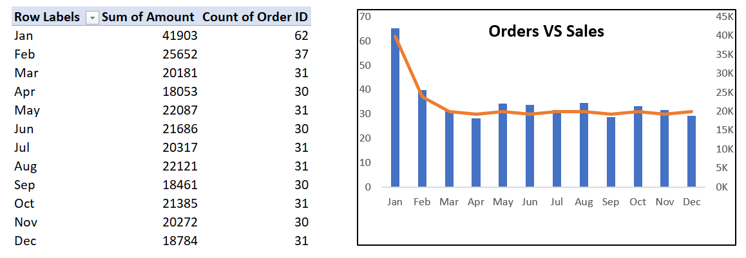
Key Questions Driving Analysis
Q.1 Compare the sales & orders using single chart ? And which month got the highest sales & orders ?

Slide 7
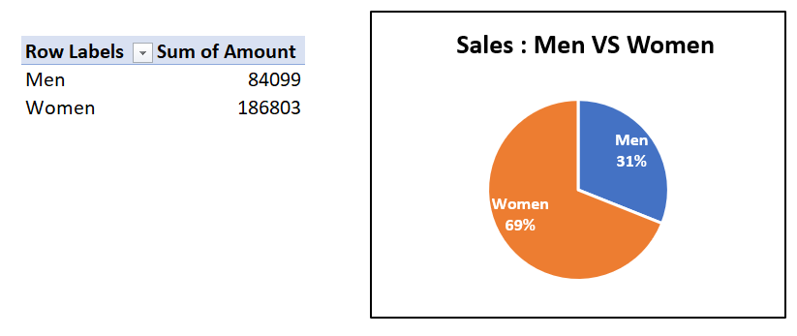
Q.2 Who purchased more Men or Women in 2023 & 2024 ?

Slide 8
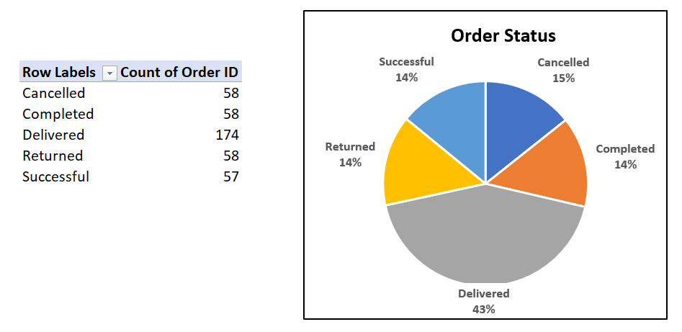
Q.3 What are different order status in 2023 & 24 ?

Slide 9
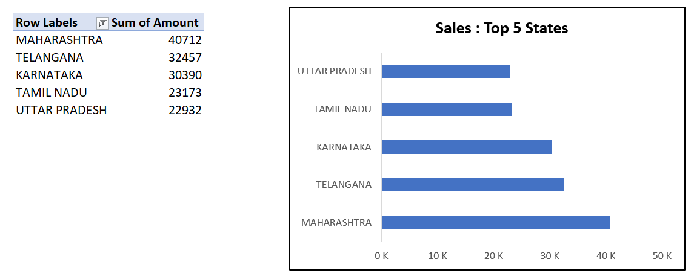
Q.4 List top 5 states contributing to the sales ?

Slide 10
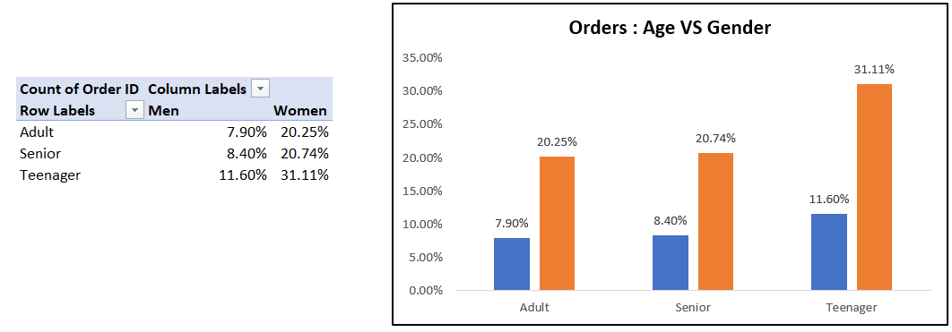
Q. 6 Relation between age & gender based on number of orders ?

Slide 11
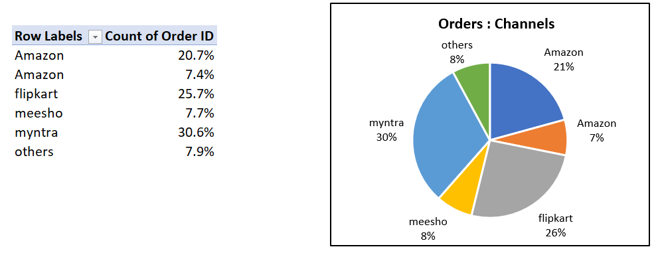
Q.5 Which channel is contributing to maximum sales ?

Slide 12
Insights
Women are more likely to buy compared to men (~69%)
Maharashtra, Karnataka and Telangana are the top 3
Teenager age group (16 – 30 yrs) is Max contribute (~31.11%)
Flipkart, Myntra & Amazon channels are maximum contributing
Final Conclusion to improve One Stop Store sales :
Target Women customers of age group (16 – 30yrs) living in Maharashtra, Karnataka & Telangana by showing ads/offers/coupons available on Flipkart, Myntra & Amazon.

Slide 13
Thank you
Name- Rutuja Pachore
Email- rutujapachore04@gmail.com
Mob- 7666411612

